Slide 1
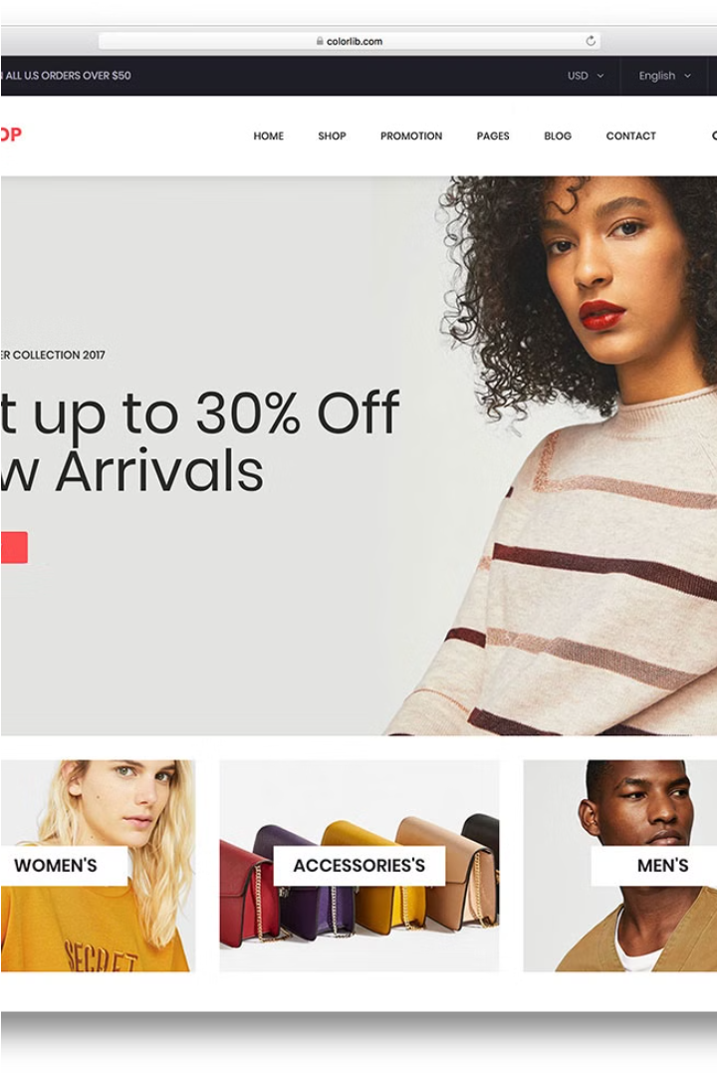

Ecommerce Store Using Commercetools
The development of this B2C ecommerce website for men's clothing represents a significant milestone in our journey towards digital commerce excellence. By leveraging the robust capabilities of Commercetools as the backend infrastructure and Next.js as the frontend framework, we have created a seamless, engaging, and responsive online shopping experience for our customers.

Slide 2

Commercetools: A Flexible and Scalable Platform
1
Microservices-based
Commercetools follows a microservices-based architecture, allowing for independent development, deployment, and management of individual business functionalities. This modular approach provides enhanced flexibility and scalability to the ecommerce platform.
2
API-first Design
Commercetools exposes all its functionality through a robust set of APIs, enabling seamless integration with other systems and the creation of custom front-end experiences tailored to our specific business needs.
3
Cloud-native SaaS
As a cloud-native Software-as-a-Service (SaaS) solution, Commercetools leverages the full capabilities of the cloud, including elastic scaling, high availability, and automatic updates, eliminating the need for manual upgrade management.

Slide 3

Headless Architecture: Unlocking Design Freedom
Decoupled Front-end
Composable Enterprise
Flexibility and Agility
The headless architecture of Commercetools allows us to completely decouple the front-end user experience from the back-end logic, granting us complete design freedom in creating the user interface and connecting to other channels and devices.
Commercetools' MACH (Microservices, API-first, Cloud-native, Headless) architecture supports a composable enterprise, where every component is pluggable, scalable, replaceable, and can be continuously improved to meet evolving business needs.
The modular and API-driven nature of Commercetools allows us to easily add, replace, or remove technologies in the future, breaking the replatform cycle and enabling us to stay agile and responsive to market changes.

Slide 4
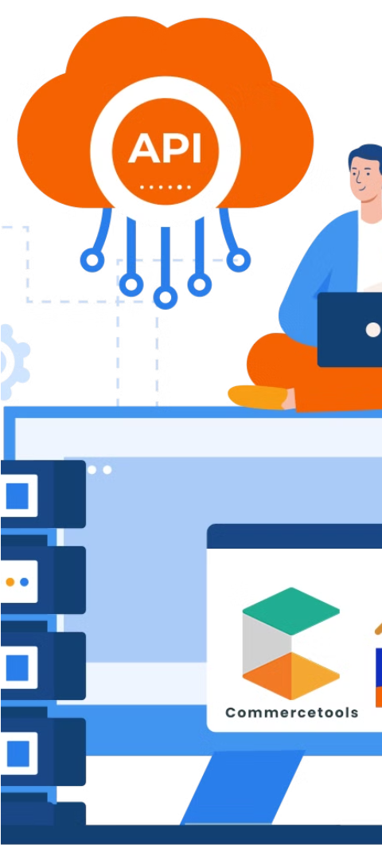
Seamless Backend Integration with Commercetools APIs
1
Authentication and Authorization
Our development team leveraged Commercetools' secure authentication and authorization mechanisms, such as API keys and OAuth tokens, to ensure the integrity and confidentiality of our backend communication and data exchange.
2
Flexible Data Modeling
Commercetools' GraphQL Data Model enabled us to define custom data types, attributes, and relationships to suit our specific business requirements, allowing for a highly extensible and adaptable ecommerce platform.
3
Real-time Integration
By integrating Commercetools' webhooks, we were able to receive real-time notifications about key events, such as order creation and inventory updates, and seamlessly integrate these updates into our backend systems for enhanced operational efficiency.

Slide 5
Crafting the Storefront: A Seamless Customer Experience
Product Catalog
Search and Navigation
Checkout and Account Management
Our storefront features a visually appealing display of products, complete with detailed descriptions, high-quality images, and transparent pricing information to provide customers with a comprehensive and engaging shopping experience.
We have implemented intuitive search capabilities and robust navigation tools, including filters and category-based browsing, to help customers easily find the products they're looking for, enhancing their overall shopping journey.
The storefront offers a streamlined and secure checkout process, allowing customers to seamlessly complete their purchases. Additionally, we have integrated features for customer account creation, order tracking, and profile management to foster a personalized and convenient shopping experience.

Slide 6
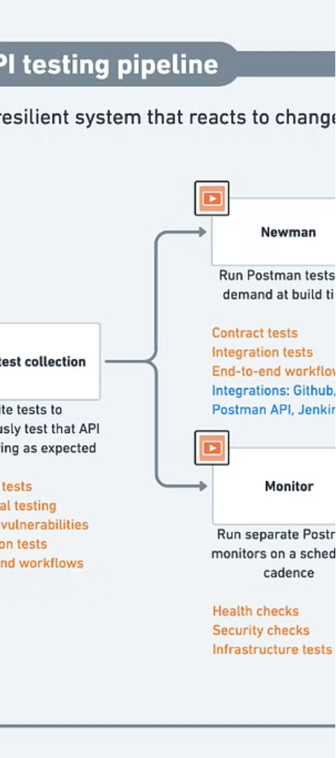
Leveraging Postman for API Testing and Debugging
1
Comprehensive API Exploration
2
Seamless Request Handling
The Postman interface allowed us to easily construct and send HTTP requests, including GET, POST, PUT, and DELETE methods, to interact with the Commercetools API and validate the expected responses.
Postman enabled our development team to thoroughly explore and understand the various API endpoints provided by Commercetools, facilitating efficient integration and ensuring the proper functioning of our backend systems.
3
Debugging and Troubleshooting
Postman's powerful debugging tools, such as request logging, response inspection, and error handling, proved invaluable in identifying and resolving any integration issues, ensuring the overall reliability and performance of our ecommerce platform.

Slide 7
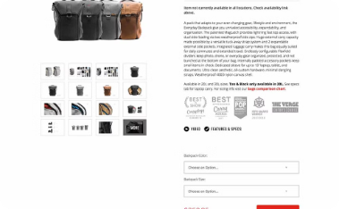


Delivering a Responsive and Engaging User Experience
Product Presentation
Shopping Cart and Checkout
Account Management
Our storefront features a visually appealing and responsive product presentation, showcasing high-quality images, detailed descriptions, and intuitive navigation to provide customers with a seamless and engaging shopping experience across various devices.
Customers can create personalized accounts, track their order history, and manage their profiles, enabling a more tailored and convenient shopping experience that fosters customer loyalty and repeat business.
The shopping cart and checkout processes are designed to be intuitive and user-friendly, allowing customers to easily review their selections, apply any relevant discounts or promotions, and securely complete their purchases.

Slide 8




Conclusion and Future Opportunities
Personalization
Omni-channel Integration
Internationalization
Enhanced Analytics
Implement advanced personalization algorithms to tailor the shopping experience based on user preferences, browsing history, and demographics, enhancing customer engagement and driving conversions.
Extend the reach of the ecommerce platform by integrating with other sales channels, such as mobile apps, social media platforms, and marketplaces, to provide a unified shopping experience across all touchpoints.
Explore opportunities to expand into international markets by offering support for multiple languages, currencies, and shipping options, customizing the website content and user interface to cater to diverse global audiences.
Implement robust analytics tools to gain deeper insights into customer behavior, sales trends, and website performance, utilizing data-driven insights to optimize product assortment, pricing strategies, and marketing campaigns.

